Slide 1

Sarcasm and Ambiguity-Aware Financial News Classification for Stock Market Impact Prediction
19CSE453 - Natural Language Processing Case Study
Team Members:
Mangalasridharan Sankar Eswaran - CB.EN.U4CCE22034
Vishal Thangakumar - CB.EN.U4CCE22053

Slide 2
Problem Statement
Financial news directly affects stock prices, but it's hard to forecast its impact.
Classic sentiment analysis models (positive/negative/neutral) usually misjudge financial text since they neglect context.
Ambiguity and hedging words ("may", "expected", "despite", "uncertain") render impact uncertain and lower model trustworthiness.
Misclassification of such news can lead to incorrect predictions of stock movements, which mislead investors

Slide 3
Novelty
Unlike other works, we formally tackle linguistic ambiguity (semantic, syntactic) of financial text, not only sentiment classification.
We introduce an ambiguity handler module based on contextual embeddings + attention/SRL to enhance interpretation of ambiguous news.
We conduct a comparative study of FinBERT and Distilled Transformer with ambiguity Handle rto check improvement in ambiguous cases.

Slide 4
Objective
To categorize financial news articles into Positive, Neutral, and Negative sentiment for stock price movement.
To create an ambiguity-aware NLP pipeline that addresses semantic and syntactic ambiguities prior to sentiment classification.
To compare performance of FinBERT baseline and ambiguity-enhanced model on Financial PhraseBank and FNSPID datasets..

Slide 5
Literature Survey
S.No | Title/Year | Source | Advantages | Disadvantages | Inference
[1] | FinBERT:Financial Sentiment Analysis with Pre-trained Language Models - 2019 | arXiv.org | Domain-specific pretraining on financial corpora → better financial text understanding. Outperforms traditional sentiment analysis methods in finance tasks. | Doesn’t explicitly resolve ambiguity types (lexical, syntactic, semantic). Limited by small fine-tuning datasets (Financial PhraseBank, FiQA). | FinBERT is our baseline model for financial sentiment classification. Its limitation in handling ambiguity motivates our ambiguity-aware model.
[2] | FNSPID: A Comprehensive Financial News Dataset in Time Series-2024 | IEEE Transactions on Affective Computing. | Large-scale dataset linking financial news with stock market impact (Positive, Neutral, Negative). | Dataset is noisy (real news headlines often ambiguous, informal, or context-dependent). | closer to real-world financial news and provides sufficient scale for training/testing ambiguity and noise - need of our work.

Slide 6
Literature Survey
S.No | Title/Year | Source | Advantages | Disadvantages | Inference
[3] | Comprehensive Review on Resolving Ambiguities in NLP-2021 | AI Open - Sciencedirect | broad survey of ambiguity types (lexical, syntactic, semantic, pragmatic) multiple approaches (rule-based, statistical, hybrid, controlled natural languages, ontology-based, transfer learning with BERT, etc.). | Not particular for finance domain Lacks a comparative evaluation across domains (tools and methods aren’t tested systematically for all ambiguity types). | Will be using the best techniques to address the ambiguities in our work.
[4] | Word Sense Disambiguation for Indic Language using Bi-LSTM | Advances in Intelligent Systems and Computing Springer | combining Word2Vec/FastText embeddings with a Bi-LSTM is well-suited for context-aware classification. | lack of explicit sarcasm handling. | contextual embeddings + Bi-LSTM form a strong baseline for handling ambiguity in financial news classification.

Slide 7
Literature Survey
S.No | Title/Year | Source | Advantages | Disadvantages | Inference
[5] | To Word Senses and Beyond: Inducing Concepts with Contextualized Language Models | Published in EMNLP 2024 main conference proceedings. | Extends beyond simple word senses to broader concepts; provides interpretable clustering; achieves performance comparable to large models while using less annotated data. | Works only for nouns; global clustering is restricted to merging clusters without splitting; relies heavily on the SemCor dataset. | Introduces Concept Induction (bi-level clustering: local sense induction + global concept clustering) using contextual embeddings.
[6] | Analysis of Attention Mechanisms: The Case of Word Sense Disambiguation | Research Gate - Proceedings Conference on Machine Translation | Attention tends to focus on the ambiguous noun itself rather than on its surrounding context. | Attention may not reliably disambiguate ambiguity or nuanced sentiment in financial texts. | Use transformer encoder + attention for base model.

Slide 8
Literature Survey
S.No | Title/Year | Source | Advantages | Disadvantages | Inference
[7] | Stock Price Trend Prediction using Emotion Analysis of Financial Headlines with Distilled LLM Model | Procedia Computer Science - ACM digital Library | Uses distilled transformer models (DistilRoBERTa) → lighter, faster, and still effective. Demonstrates that financial headlines alone carry strong predictive signals via emotional analysis. | Focused only on emotion classification, not ambiguity (semantic/syntactic issues remain unaddressed). Evaluated on a narrow scope (32 mega-cap companies) → limited generalization. | headline-level transformer models effectively capture financial signals. DistilBERT/DistilRoBERTa for efficiency in our project.
[8] |  | Expert Systems With Applications Elsevier | Reduces noise by 30% in event detection via WSD, improving stock prediction precision by filtering ambiguous high-impact events. | High computational cost from graph-based WSD, Relies on WordNet | Integrate WSD as preprocessing for BERT to handle semantic ambiguities in news classification

Slide 9
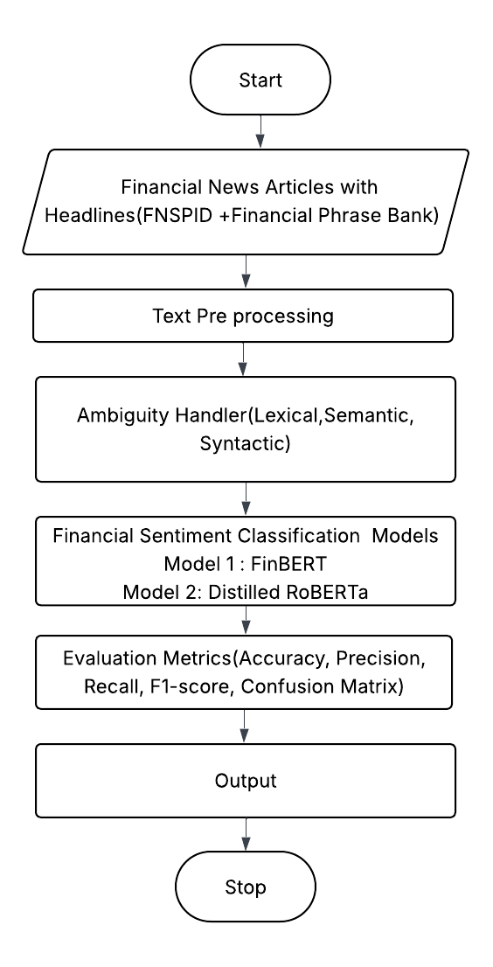
Methodology

Slide 10
Evaluation Metrics
Accuracy, Precision, Recall, F1-score (overall).
Confusion matrix for error analysis.

